Slide 1
HPL (High performance Linpack) – uses MPI
https://iu.mediaspace.kaltura.com/media/L4+HPCC+Demo/1_1u4wmifb/65633621
https://iu.mediaspace.kaltura.com/media/L4+HPCG+Demo/1_161roeeo/65633621
https://iu.mediaspace.kaltura.com/media/L4+HPCG+Demo/1_4zcbsla5/65633621

Slide 2
The Essential MPI

Slide 3
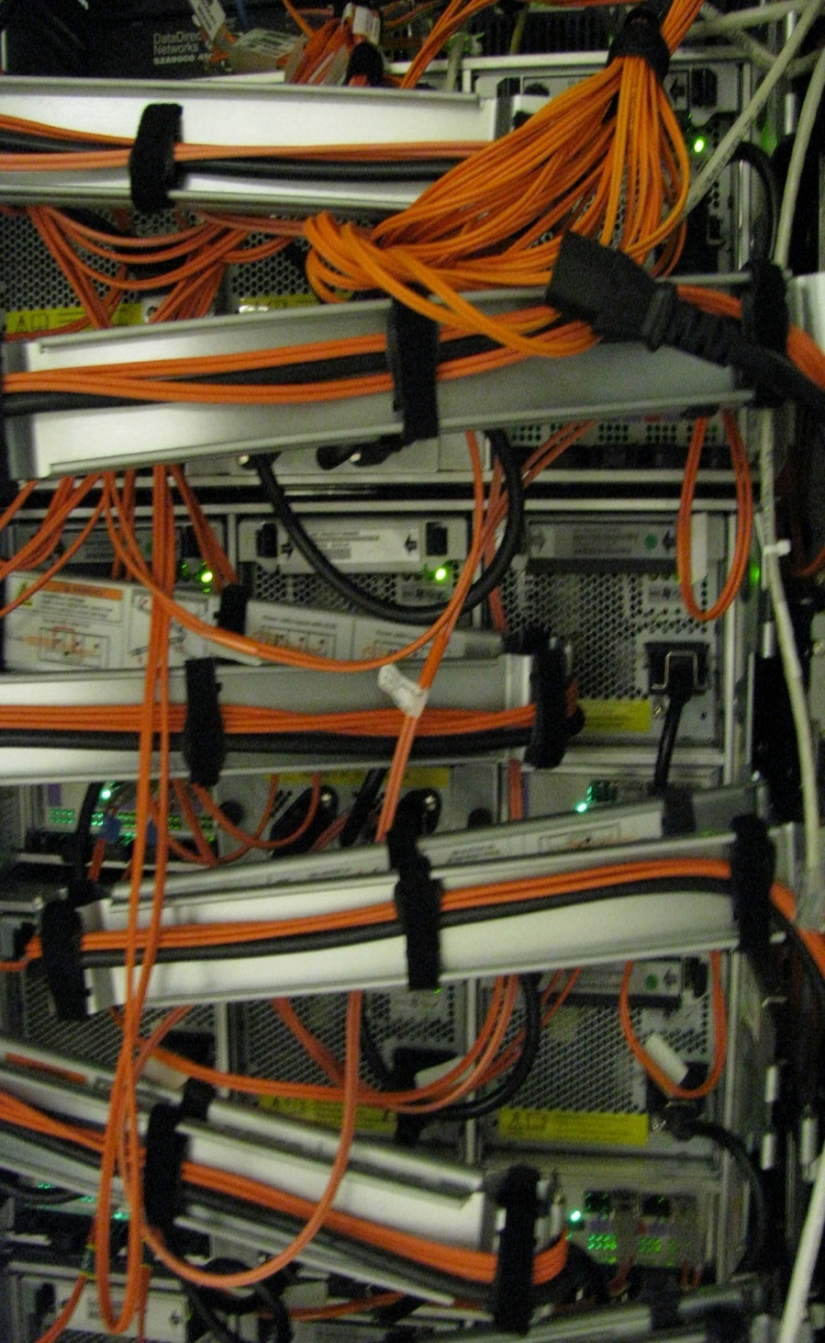
Message Passing Interface MPI
Introduction
MPI Standard
MPI-1 Model and Basic Calls
MPI Communicators
Point to Point Communication
MPI Collective Calls: Synchronization Primitives
MPI Collective Calls: Communication Primitives
MPI Collective Calls: Reduction Primitives

Slide 4
Opening Remarks
Context: distributed memory parallel computers
We have communicating sequential processes, each with their own memory, and no access to another process’s memory
A fairly common scenario from the mid 1980s (Intel Hypercube) to today
Processes interact (exchange data, synchronize) through message passing
Initially, each computer vendor had its own library and calls
First standardization was PVM
Started in 1989, first public release in 1991
Worked well on distributed machines
Next was MPI

Slide 5
What You’ll Need to Know
What is a standard API
How to build and run an MPI-1 program
Basic MPI functions
4 basic environment functions
Including the idea of communicators
Basic point-to-point functions
Blocking and non-blocking
Deadlock and how to avoid it
Data types
Basic collective functions
The advanced MPI-1 material may be required for the problem set
The MPI-2 highlights are just for information

Slide 6
MPI Standard
From 1992-1994, a community representing both vendors and users decided to create a standard interface to message passing calls in the context of distributed memory parallel computers (MPPs, there weren’t really clusters yet)
MPI-1 was the result
“Just” an API
FORTRAN77 and C bindings
Reference implementation (mpich) also developed
Vendors also kept their own internals (behind the API)

Slide 7
MPI Standard
Since then
MPI-1.1
Fixed bugs, clarified issues
MPI-2
Included MPI-1.2
Fixed more bugs, clarified more issues
Extended MPI
New datatype constructors, language interoperability
New functionality
One-sided communication
MPI I/O
Dynamic processes
FORTRAN90 and C++ bindings
Best MPI reference
MPI Standard - on-line at: http://www.mpi-forum.org/

Slide 8
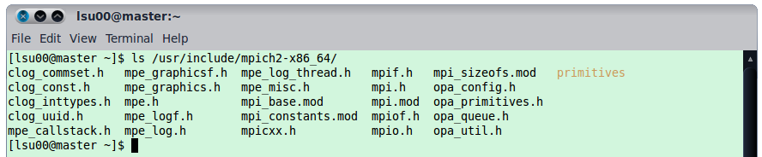
MPI: Basics
Every MPI program must contain the preprocessor directive
The mpi.h file contains the definitions and declarations necessary for compiling an MPI program.
mpi.h is usually found in the “include” directory of most MPI installations. For example on arete:
#include "mpi.h"
...
#include “mpi.h”
...
MPI_Init(&Argc,&Argv);
...
...
MPI_Finalize();
...

Slide 9
MPI: Initializing MPI Environment
Function: | MPI_init()
int MPI_Init(int *argc, char ***argv)
Description: Initializes the MPI execution environment. MPI_init() must be called before any other MPI functions can be called and it should be called only once. It allows systems to do any special setup so that MPI Library can be used. argc is a pointer to the number of arguments and argv is a pointer to the argument vector. On exit from this routine, all processes will have a copy of the argument list.
...
#include “mpi.h”
...
MPI_Init(&argc,&argv);
...
...
MPI_Finalize();
...
http://www-unix.mcs.anl.gov/mpi/www/www3/MPI_Init.html

Slide 10
MPI: Terminating MPI Environment
Function: | MPI_Finalize()
int MPI_Finalize()
Description: Terminates MPI execution environment. All MPI processes must call this routine before exiting. MPI_Finalize() need not be the last executable statement or even in main; it must be called at somepoint following the last call to any other MPI function.
...
#include ”mpi.h”
...
MPI_Init(&argc,&argv);
...
...
MPI_Finalize();
...
http://www-unix.mcs.anl.gov/mpi/www/www3/MPI_Finalize.html

Slide 11
MPI Hello World
C source file for a simple MPI Hello World
Include header files
#include "mpi.h"
#include <stdio.h>
int main( int argc, char *argv[])
{
MPI_Init( &argc, &argv);
printf("Hello, World!\n");
MPI_Finalize();
return 0;
}
Initialize MPI Context
Finalize MPI Context

Slide 12

MPI Communicators
Communicator is an internal object
MPI Programs are made up of communicating processes
Each process has its own address space containing its own attributes such as rank, size (and argc, argv, etc.)
MPI provides functions to interact with it
Default communicator is MPI_COMM_WORLD
All processes are its members
It has a size (the number of processes)
Each process has a rank within it
One can think of it as an ordered list of processes
Additional communicator(s) can co-exist
A process can belong to more than one communicator
Within a communicator, each process has a unique rank
MPI_COMM_WORLD
5
0
6
3
2
1
7
4

Slide 13
MPI: Size of Communicator
Function: | MPI_Comm_size()
int MPI_Comm_size ( MPI_Comm comm, int *size )
Description: Determines the size of the group associated with a communicator (comm). Returns an integer number of processes in the group underlying comm executing the program. If comm is an inter-communicator (i.e. an object that has processes of two inter-communicating groups) , return the size of the local group (a size of a group where request is initiated from). The comm in the argument list refers to the communicator-group to be queried, the result of the query (size of the comm group) is stored in the variable size.
...
#include “mpi.h”
...
int size;
MPI_Init(&Argc,&Argv);
...
MPI_Comm_size(MPI_COMM_WORLD, &size);
MPI_Comm_rank(MPI_COMM_WORLD, &rank);
...
err = MPI_Finalize();
...
http://www-unix.mcs.anl.gov/mpi/www/www3/MPI_Comm_size.html

Slide 14
MPI: Rank of a process in comm
Function: | MPI_Comm_rank()
int MPI_Comm_rank ( MPI_Comm comm, int *rank )
Description: Returns the rank of the calling process in the group underlying the comm. If the comm is an inter-communicator, the call MPI_Comm_rank returns the rank of the process in the local group. The first parameter comm in the argument list is the communicator to be queried, and the second parameter rank is the integer number rank of the process in the group of comm.
...
#include “mpi.h”
...
int rank;
MPI_Init(&Argc,&Argv);
...
MPI_Comm_size(MPI_COMM_WORLD, &size);
MPI_Comm_rank(MPI_COMM_WORLD, &rank);
...
err = MPI_Finalize();
...
http://www-unix.mcs.anl.gov/mpi/www/www3/MPI_Comm_rank.html

Slide 15
Example: communicators
#include "mpi.h"
#include <stdio.h>
int main( int argc, char *argv[])
{
int rank, size;
MPI_Init( &argc, &argv);
MPI_Comm_rank( MPI_COMM_WORLD, &rank);
MPI_Comm_size( MPI_COMM_WORLD, &size);
printf("Hello, World! from %d of %d\n", rank, size );
MPI_Finalize();
return 0;
}
Determines the rank of the current process in the communicator-group MPI_COMM_WORLD
Determines the size of the communicator-group MPI_COMM_WORLD
… Hello, World! from 1 of 8
Hello, World! from 0 of 8
Hello, World! from 5 of 8
…

Slide 16
Example: Communicator & Rank
Compiling :
Result :
mpicc -o hello2 hello2.c
Hello, World! from 4 of 8
Hello, World! from 3 of 8
Hello, World! from 1 of 8
Hello, World! from 0 of 8
Hello, World! from 5 of 8
Hello, World! from 6 of 8
Hello, World! from 7 of 8
Hello, World! from 2 of 8

Slide 17
MPI : Point to Point Communication primitives
A basic communication mechanism of MPI between a pair of processes in which one process is sending data and the other process receiving the data, is called “point to point communication”
Message passing in MPI program is carried out by 2 main MPI functions
MPI_Send – sends message to a designated process
MPI_Recv – receives a message from a process
Each of the send and recv calls is appended with additional information along with the data that needs to be exchanged between application programs
The message envelope consists of the following information
The rank of the receiver
The rank of the sender
A tag
A communicator
The source argument is used to distinguish messages received from different processes
Tag is user-specified int that can be used to distinguish messages from a single process

Slide 18
Message Envelope
Source : process0
Destination : process1
Tag : 1234
Communicator : MPI_COMM_WORLD
Communication across processes is performed using messages.
Each message consists of a fixed number of fields that is used to distinguish them, called the Message Envelope :
Envelope comprises source, destination, tag, communicator
Message = Envelope + Data
Communicator refers to the namespace associated with the group of related processes
MPI_COMM_WORLD
5
0
6
3
2
1
7
4

Slide 19
MPI: (blocking) Send message
Function: | MPI_Send()
int MPI_Send( void *message, int count, MPI_Datatype datatype, int dest, int tag, MPI_Comm comm )
Description: The contents of message are stored in a block of memory referenced by the first parameter message. The next two parameters, count and datatype, allow the system to determine how much storage is needed for the message: the message contains a sequence of count values, each having MPI type datatype. MPI allows a message to be received as long as there is sufficient storage allocated. If there isn't sufficient storage an overflow error occurs. The dest parameter corresponds to the rank of the process to which message has to be sent.
http://www-unix.mcs.anl.gov/mpi/www/www3/MPI_Send.html

Slide 20
MPI: Data Types
MPI datatype | C datatype
MPI_CHAR | signed char
MPI_SHORT | signed short int
MPI_INT | signed int
MPI_LONG | signed long int
MPI_UNSIGNED_CHAR | unsigned char
MPI_UNSIGNED_SHORT | unsigned short int
MPI_UNSIGNED | unsigned int
MPI_UNSIGNED_LONG | unsigned long int
MPI_FLOAT | float
MPI_DOUBLE | double
MPI_LONG_DOUBLE | long double
MPI_BYTE
MPI_PACKED
You can also define your own (derived datatypes), such as an array of ints of size 100, or more complex examples, such as a struct or an array of structs

Slide 21
MPI: (blocking) Receive message
Function: | MPI_Recv()
int MPI_Recv( void *message, int count, MPI_Datatype datatype, int source, int tag, MPI_Comm comm, MPI_Status *status )
Description: The contents of message are stored in a block of memory referenced by the first parameter message. The next two parameters, count and datatype, allow the system to determine how much storage is needed for the message: the message contains a sequence of count values, each having MPI type datatype. MPI allows a message to be received as long as there is sufficient storage allocated. If there isnt sufficient storage an overflow error occurs. The source parameter corresponds to the rank of the process from which the message has been received. The MPI_Status parameter in the MPI_Recv() call returns information on the data that was actually received It references a record with 2 fields – one for the source and one for the tag
www-unix.mcs.anl.gov/mpi/www/www3/MPI_Recv.html

Slide 22
MPI_Status object
Object: | MPI_Status
Example usage : MPI_Status status;
Description: The MPI_Status object is used by the receive functions to return data about the message, specifically the object contains the id of the process sending the message (MPI_SOURCE), the message tag (MPI_TAG), and error status (MPI_ERROR) .
#include "mpi.h"
…
MPI_Status status; /* return status for */
…
MPI_Init(&argc, &argv);
…
if (my_rank != 0) {
…
MPI_Send(message, strlen(message)+1, MPI_CHAR, dest, tag, MPI_COMM_WORLD);
}
else { /* my rank == 0 */
for (source = 1; source < p; source++ ) {
MPI_Recv(message, 100, MPI_CHAR, source, tag, MPI_COMM_WORLD, &status);
…
MPI_Finalize();
…

Slide 23
MPI: Example send/recv
/* hello world, MPI style */
#include "mpi.h"
#include <stdio.h>
#include <string.h>
int main(int argc, char* argv[])
{
int my_rank; /* rank of process */
int p; /* number of processes */
int source; /* rank of sender */
int dest; /* rank of receiver */
int tag=0; /* tag for messages */
char message[100]; /* storage for message */
MPI_Status status; /* return status for */
/* receive */
/* Start up MPI */
MPI_Init(&argc, &argv);
/* Find out process rank */
MPI_Comm_rank(MPI_COMM_WORLD, &my_rank);
/* Find out number of processes */
MPI_Comm_size(MPI_COMM_WORLD, &p);
if (my_rank != 0) {
/* Create message */
sprintf(message, "Greetings from process %d!", my_rank);
dest = 0;
/* Use strlen+1 so that \0 gets transmitted */
MPI_Send(message, strlen(message)+1, MPI_CHAR, dest, tag, MPI_COMM_WORLD);
}
else { /* my rank == 0 */
for (source = 1; source < p; source++ ) {
MPI_Recv(message, 100, MPI_CHAR, source, tag, MPI_COMM_WORLD, &status);
printf("%s\n", message);
}
printf("Greetings from process %d!\n", my_rank);
}
/* Shut down MPI */
MPI_Finalize();
} /* end main */

Slide 24
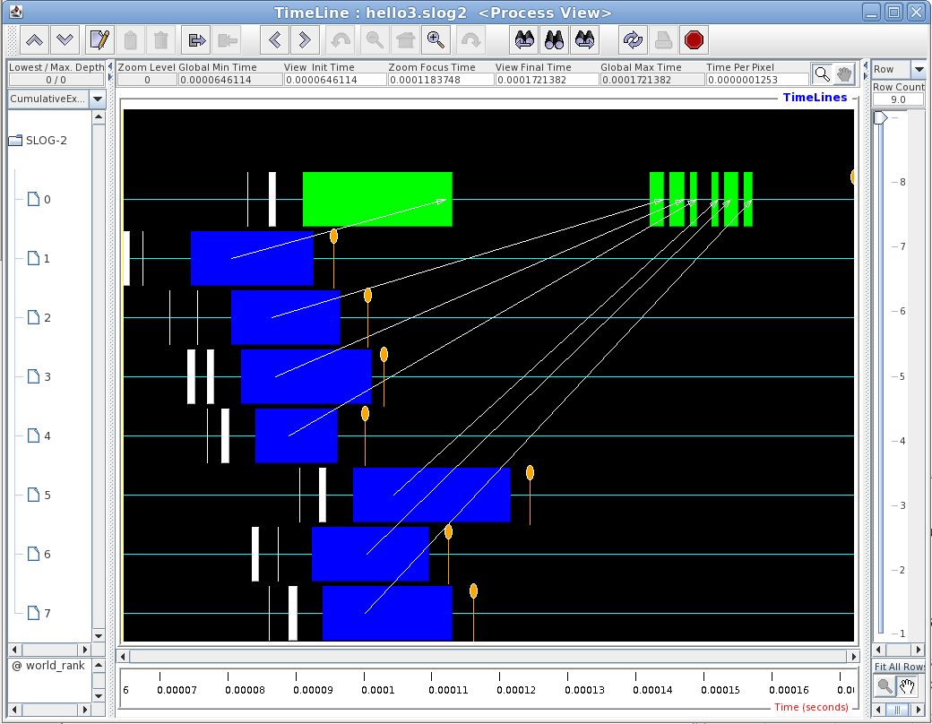
Communication map for the example.
mpiexec -n 8 ./hello3
Greetings from process 1!
Greetings from process 2!
Greetings from process 3!
Greetings from process 4!
Greetings from process 5!
Greetings from process 6!
Greetings from process 7!
Greetings from process 0!
Writing logfile....
Finished writing logfile.
[cdekate@celeritas l7]$

Slide 25
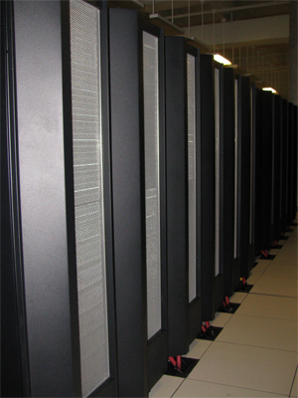
Review of Basic MPI Calls
In review, the 6 main MPI calls:
MPI_Init
MPI_Finalize
MPI_Comm_size
MPI_Comm_rank
MPI_Send
MPI_Recv
Include MPI Header file
#include “mpi.h”
Basic MPI Datatypes
MPI_INT, MPI_FLOAT, ….

Slide 26
Collective Calls
A communication pattern that encompasses all processes within a communicator is known as
collective communication
MPI has several collective communication calls, the most frequently used are:
Synchronization
Barrier
Communication
Broadcast
Gather & Scatter
All Gather
Reduction
Reduce
AllReduce

Slide 27
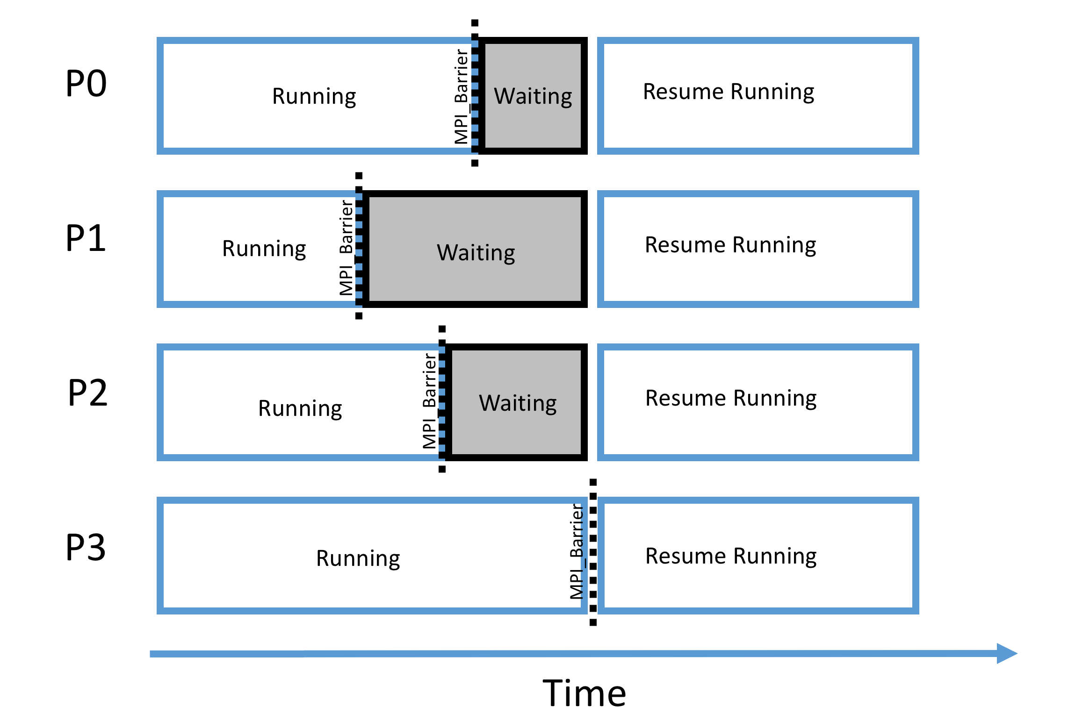
MPI Collective Calls: Barrier
Function: | MPI_Barrier()
int MPI_Barrier ( MPI_Comm comm )
Description: Creates barrier synchronization in a communicator group comm. Each process, when reaching the MPI_Barrier call, blocks until all the processes in the group reach the same MPI_Barrier call.
http://www-unix.mcs.anl.gov/mpi/www/www3/MPI_Barrier.html

Slide 28
Example: MPI_Barrier()
#include <stdio.h>
#include "mpi.h"
int main (int argc, char *argv[]){
int rank, size, len;
char name[MPI_MAX_PROCESSOR_NAME];
MPI_Init(&argc, &argv);
MPI_Barrier(MPI_COMM_WORLD);
MPI_Comm_rank(MPI_COMM_WORLD, &rank);
MPI_Comm_size(MPI_COMM_WORLD, &size);
MPI_Get_processor_name(name, &len);
MPI_Barrier(MPI_COMM_WORLD);
printf ("Hello world! Process %d of %d on %s\n", rank, size, name);
MPI_Finalize();
return 0;
}
[cdekate@celeritas collective]$ mpirun -np 8 barrier
Hello world! Process 0 of 8 on celeritas.cct.lsu.edu
Writing logfile....
Finished writing logfile.
Hello world! Process 4 of 8 on compute-0-3.local
Hello world! Process 1 of 8 on compute-0-0.local
Hello world! Process 3 of 8 on compute-0-2.local
Hello world! Process 6 of 8 on compute-0-5.local
Hello world! Process 7 of 8 on compute-0-6.local
Hello world! Process 5 of 8 on compute-0-4.local
Hello world! Process 2 of 8 on compute-0-1.local
[cdekate@celeritas collective]$

Slide 29
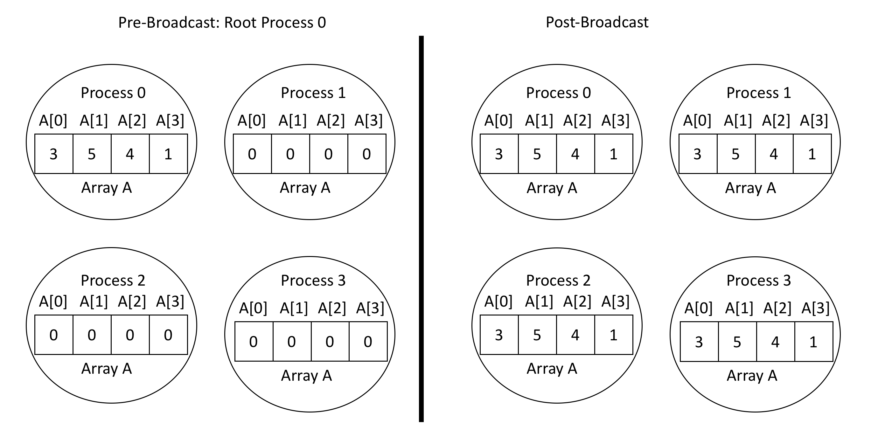
Collective Data Movement

Slide 30
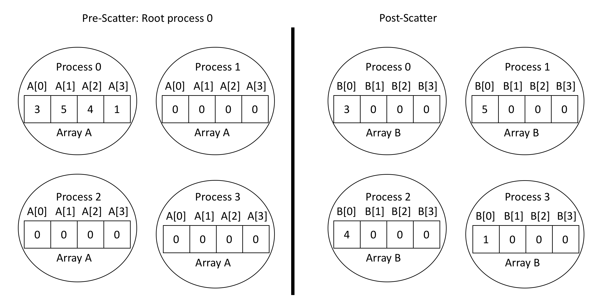
Collective Data Movement

Slide 31
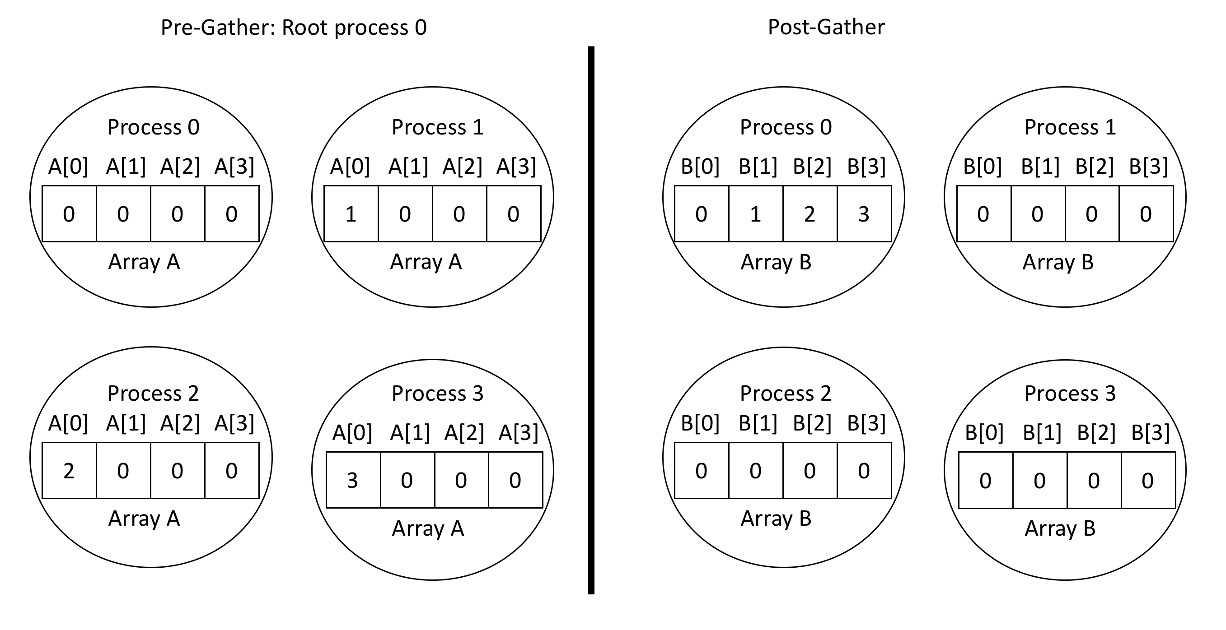
Collective Data Movement

Slide 32
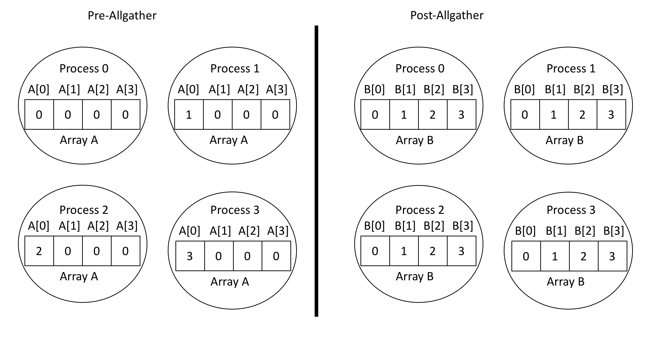
Collective Data Movement

Slide 33
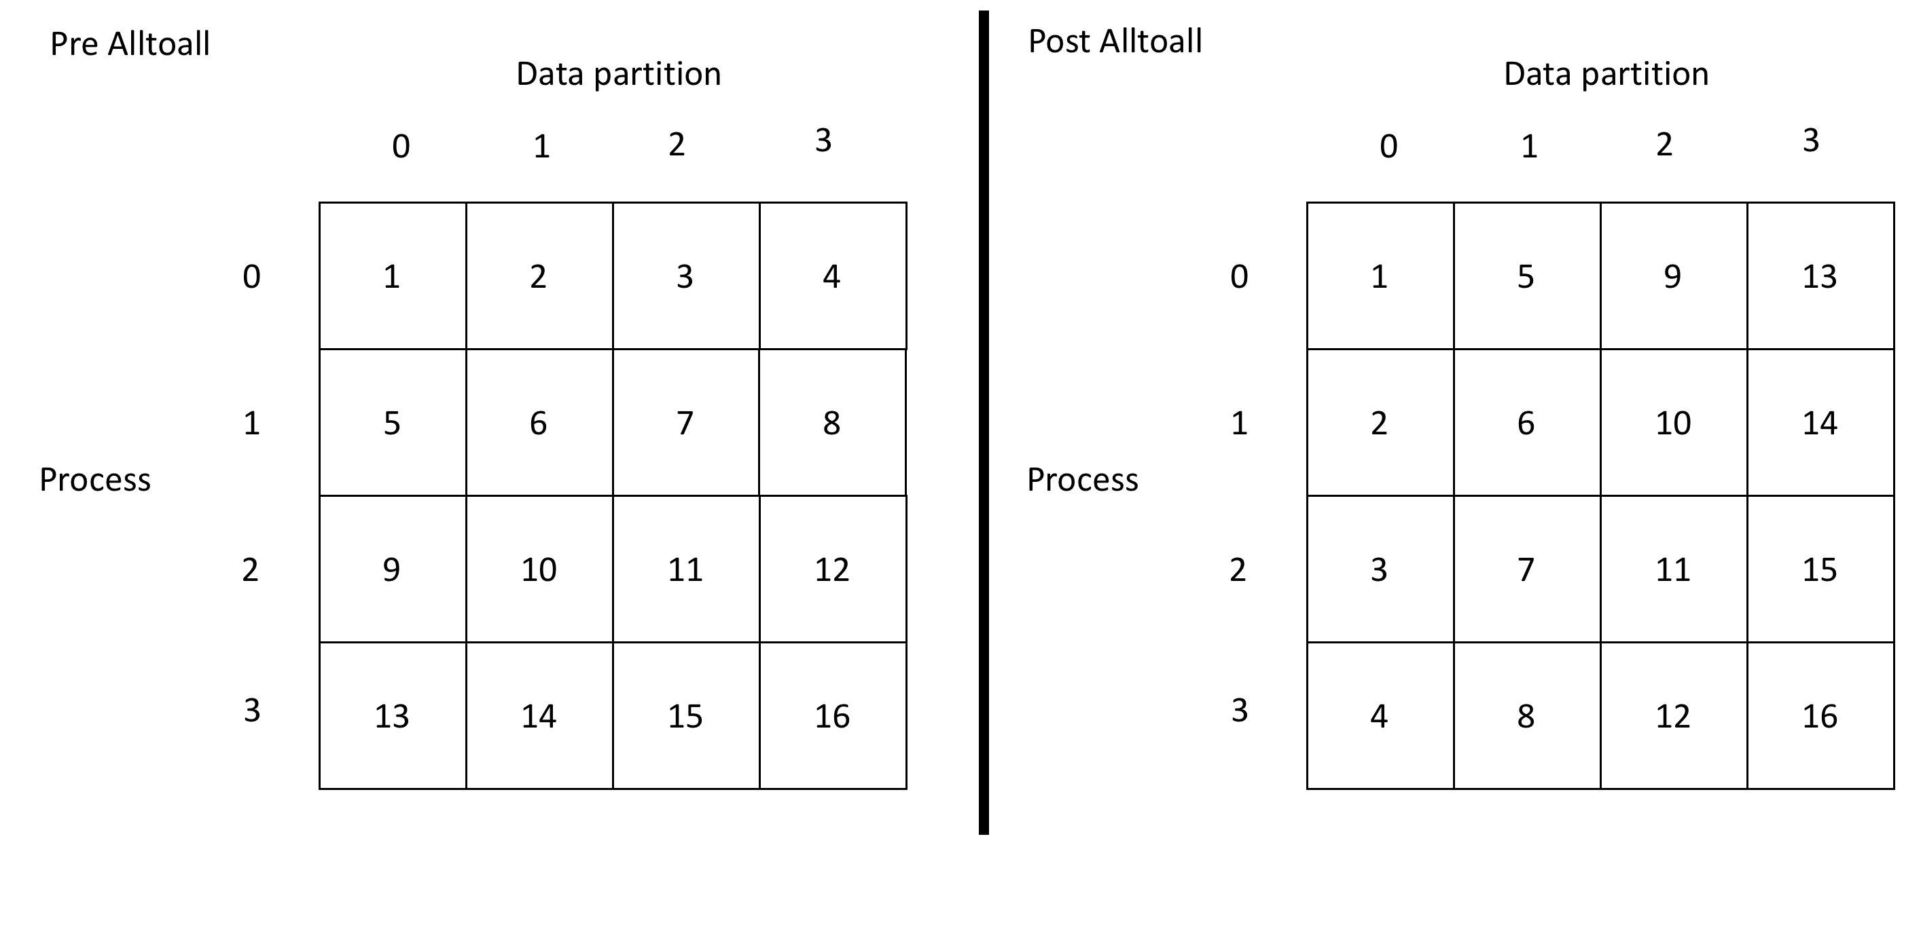
Collective Data Movement

Slide 34
MPI Collective Calls: Broadcast
Function: | MPI_Bcast()
int MPI_Bcast ( void *message, int count, MPI_Datatype datatype, int root, MPI_Comm comm )
Description: A collective communication call where a single process sends the same data contained in the message to every process in the communicator. By default a tree like algorithm is used to broadcast the message to a block of processors, a linear algorithm is then used to broadcast the message from the first process in a block to all other processes. All the processes invoke the MPI_Bcast call with the same arguments for root and comm,
float endpoint[2];
...
MPI_Bcast(endpoint, 2, MPI_FLOAT, 0, MPI_COMM_WORLD);
...
http://www-unix.mcs.anl.gov/mpi/www/www3/MPI_Bcast.html

Slide 35
MPI Collective Calls: Scatter
Function: | MPI_Scatter()
int MPI_Scatter ( void *sendbuf, int send_count, MPI_Datatype send_type, void *recvbuf, int recv_count, MPI_Datatype recv_type, int root, MPI_Comm comm)
Description: MPI_Scatter splits the data referenced by the sendbuf on the process with rank root into p segments each of which consists of send_count elements of type send_type. The first segment is sent to process0 and the second segment to process1.The send arguments are significant on the process with rank root.
...
MPI_Scatter(&(local_A[0][0]), n/p, MPI_FLOAT, row_segment, n/p, MPI_FLOAT, 0,MPI_COMM_WORLD);
...

Slide 36
MPI Collective Calls: Gather
Function: | MPI_Gather()
int MPI_Gather ( void *sendbuf, int send_count, MPI_Datatype sendtype, void *recvbuf, int recvcount, MPI_Datatype recvtype, int root, MPI_Comm comm )
Description: MPI_Gather collects the data referenced by sendbuf from each process in the communicator comm, and stores the data in process rank order on the process with rank root in the location referenced by recvbuf.The recv parameters are only significant.
...
MPI_Gather(local_x, n/p, MPI_FLOAT, global_x, n/p, MPI_FLOAT, 0, MPI_COMM_WORLD);
...
http://www-unix.mcs.anl.gov/mpi/www/www3/MPI_Gather.html

Slide 37
MPI Collective Calls: All Gather
Function: | MPI_Allgather()
int MPI_Allgather ( void *sendbuf, int send_count, MPI_Datatype sendtype, void *recvbuf, int recvcount, MPI_Datatype recvtype, MPI_Comm comm )
Description: MPI_Allgather gathers the content from the send buffer (sendbuf) on each process. The effect of this call is similar to executing MPI_Gather() p times with a different process acting as the root.
for (root=0; root<p; root++)
MPI_Gather(local_x, n/p, MPI_FLOAT, global_x, n/p, MPI_FLOAT, root, MPI_COMM_WORLD);
...
CAN BE REPLACED WITH :
MPI_Allgather(local_x, local_n, MPI_FLOAT, global_x, local_n, MPI_FLOAT, MPI_COMM_WORLD);
http://www-unix.mcs.anl.gov/mpi/www/www3/MPI_Allgather.html

Slide 38
Collective Example (in the lab)
#include “mpi.h”
int main ( int argc, char **argv )
{
int n, i, pool_size, my_rank;
double mypi, pi, h, sum, x, a;
MPI_Init(&argc, &argv);
MPI_Comm_size(MPI_COMM_WORLD, &pool_size);
MPI_Comm_rank(MPI_COMM_WORLD, &my_rank);
int ROOT = 0; //sri addition
if (my_rank == ROOT) {
printf("Enter the number of intervals: ");
scanf("%d",&n);
if (n==0) n=100;
}
MPI_Bcast(&n, 1, MPI_INT, ROOT, MPI_COMM_WORLD);
Notes:
ROOT =0
https://www.mcs.anl.gov/research/projects/mpi/tutorial/mpiexmpl/src/pi/C/main.html

Slide 39
Collective Example, Continued
h = 1.0 / (double) n;
sum = 0.0;
for (i = my_rank + 1; i <= n; i += pool_size) {
x = h * ((double)i - 0.5);
sum += 4.0 / (1.0 + x*x);
}
mypi = h * sum;
MPI_Reduce(&mypi, &pi, 1, MPI_DOUBLE, MPI_SUM, ROOT,
MPI_COMM_WORLD);
if (my_rank == ROOT) printf("\npi is approximately %.16f\n", pi);
MPI_Finalize();
return 0;
}

Slide 40
MPI Collective Calls: Reduce
Function: | MPI_Reduce()
int MPI_Reduce ( void *operand, void *result, int count, MPI_Datatype datatype, MPI_Op operator, int root, MPI_Comm comm )
Description: A collective communication call where all the processes in a communicator contribute data that is combined using binary operations (MPI_Op) such as addition, max, min, logical, and, etc. MPI_Reduce combines the operands stored in the memory referenced by operand using the operation operator and stores the result in *result. MPI_Reduce is called by all the processes in the communicator comm and for each of the processes count, datatype operator and root remain the same.
...
MPI_Reduce(&local_integral, &integral, 1, MPI_FLOAT, MPI_SUM, 0, MPI_COMM_WORLD);
...
http://www-unix.mcs.anl.gov/mpi/www/www3/MPI_Reduce.html

Slide 41
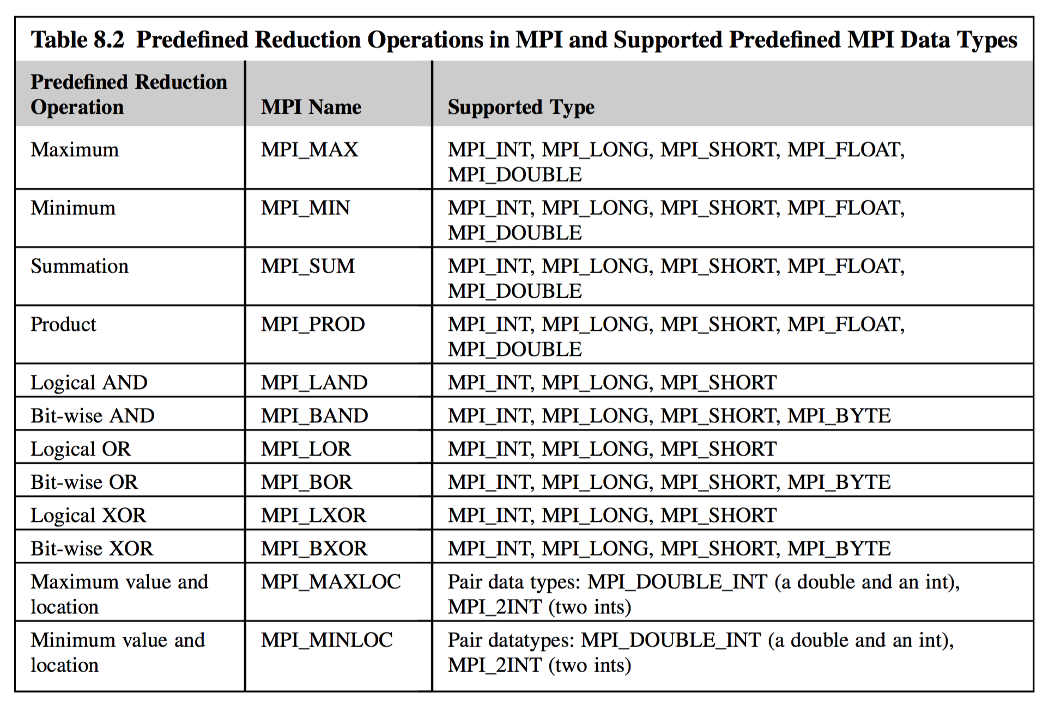
MPI Binary Operations
MPI binary operators are used in the MPI_Reduce function call as one of the parameters. MPI_Reduce performs a global reduction operation (dictated by the MPI binary operator parameter) on the supplied operands.
The predefined MPI Operators used are :

Slide 42
MPI Collective Calls: All Reduce
Function: | MPI_Allreduce()
int MPI_Allreduce ( void *sendbuf, void *recvbuf, int count, MPI_Datatype datatype, MPI_Op op, MPI_Comm comm )
Description: MPI_Allreduce is used exactly like MPI_Reduce, except that the result of the reduction is returned on all processes, as a result there is no root parameter.
P0
A
P0
A+B+C+D
P1
B
All Reduce
P1
A+B+C+D
Binary Op = MPI_SUM
P2
C
P2
A+B+C+D
P3
D
P3
A+B+C+D
...
MPI_Allreduce(&integral, &integral, 1, MPI_FLOAT, MPI_SUM, MPI_COMM_WORLD);
...
http://www-unix.mcs.anl.gov/mpi/www/www3/MPI_Allreduce.html

Slide 43
Point to Point Communication Non-blocking Calls
When the system buffer is full, the blocking send would have to wait until the receiving task pulled some message data out of the buffer. Use of non-blocking call allows computation to be done during this interval, allowing for interleaving of computation and communication
Non-blocking calls ensure that deadlock will not result

Slide 44
Deadlock
Something to avoid
A situation where the dependencies between processors are cyclic
One processor is waiting for a message from another processor, but that processor is waiting for a message from the first, so nothing happens
Until your time in the queue runs out and your job is killed
MPI does not have timeouts

Slide 45
Deadlock Example
If (rank == 0) {
err = MPI_Send(sendbuf, count, datatype, 1, tag, comm);
err = MPI_Recv(recvbuf, count, datatype, 1, tag, comm, &status);
}else {
err = MPI_Send(sendbuf, count, datatype, 0, tag, comm);
err = MPI_Recv(recvbuf, count, datatype, 0, tag, comm, &status);
}
If the message sizes are small enough, this should work because of systems buffers
If the messages are too large, or system buffering is not used, this will hang

Slide 46
Deadlock Example Solutions
If (rank == 0) {
err = MPI_Send(sendbuf, count, datatype, 1, tag, comm);
err = MPI_Recv(recvbuf, count, datatype, 1, tag, comm, &status);
}else {
err = MPI_Recv(recvbuf, count, datatype, 0, tag, comm, &status);
err = MPI_Send(sendbuf, count, datatype, 0, tag, comm);
}
or
If (rank == 0) {
err = MPI_Isend(sendbuf, count, datatype, 1, tag, comm, &req);
err = MPI_Irecv(recvbuf, count, datatype, 1, tag, comm);
err = MPI_Wait(req, &status);
}else {
err = MPI_Isend(sendbuf, count, datatype, 0, tag, comm, &req);
err = MPI_Irecv(recvbuf, count, datatype, 0, tag, comm);
err = MPI_Wait(req, &status);
}

Slide 47
MPI Profiling: MPI_ Wtime
Function: | MPI_Wtime()
double MPI_Wtime()
Description: Returns time in seconds elapsed on the calling processor. Resolution of time scale is determined by the MPI environment variable MPI_WTICK. When the MPI environment variable MPI_WTIME_IS_GLOBAL is defined and set to true, the the value of MPI_Wtime is synchronized across all processes in MPI_COMM_WORLD
double time0;
...
time0 = MPI_Wtime();
...
printf("Hello From Worker #%d %lf \n", rank, (MPI_Wtime() – time0));
http://www-unix.mcs.anl.gov/mpi/www/www3/MPI_Wtime.html
55
Notes:
Maciek might have the updated notes on this.

Slide 48
Timing Example: MPI_Wtime
#include <stdio.h>
#include ”mpi.h”
main(int argc, char **argv)
{
int size, rank;
double time0, time1;
MPI_Init(&argc, &argv);
MPI_Comm_rank(MPI_COMM_WORLD, &rank);
MPI_Comm_size(MPI_COMM_WORLD, &size);
time0 = MPI_Wtime();
if(rank==0)
{
printf(" Hello From Proc0 Time = %lf \n", (MPI_Wtime() – time0));
}
else
{
printf("Hello From Worker #%d %lf \n", rank, (MPI_Wtime() – time0));
}
MPI_Finalize();
}
56
Notes:
Maciek might have the updated notes on this.

